Slide 1

Hw5 (G)
第37組 通訊三 108503002 謝佩玲
通訊三 108503503 陳彥棻
通訊三 108601020 陳泊言

Slide 2
題目
令S = (-2, 1, -3, 4, -1, 2, 1, -5, 4),
使用動態規劃演算法求出最大連續非空子序列和

Slide 3
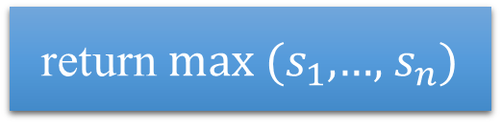
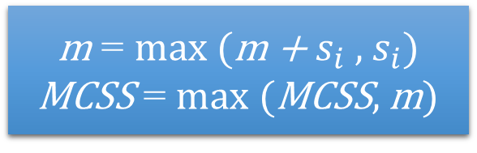
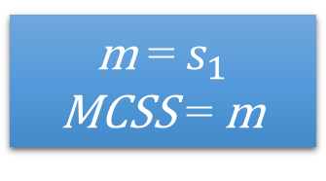
01
Flow chart
start
所有整數均為負數
false
m = $s_{1}$
MCSS = m
true
i = 2
return max ($s_{1}$,…, $s_{n}$)
return MCSS
false
i <= n
true
m = max (m + $s_{i}$ , $s_{i}$)
MCSS = max (MCSS, m)
end
i ++

Slide 4
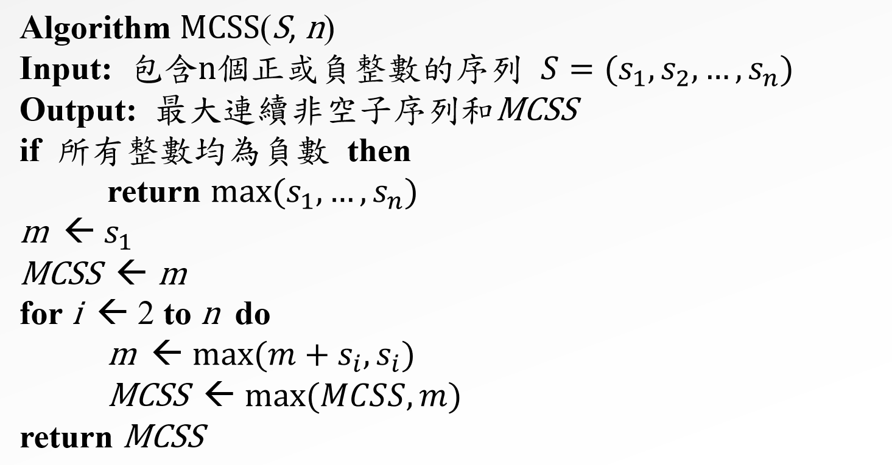

02
Pseudo code
Algorithm MCSS(S, n)
Input: 包含n個正或負整數的序列 $S=(s_{1}, s_{2}, …, s_{n})$
Output: 最大連續非空子序列和MCSS
if 所有整數均為負數 then
return $max⁡(s_{1}, …, s_{n})$
m ← $s_{1}$
MCSS ← m
for i ← 2 to n do
m ← $max⁡(m+s_{i}, s_{i})$
MCSS ← $max⁡(MCSS, m)$
return MCSS

Slide 5

03
Dynamic programming
m = -2
MCSS = -2
-2 1 -3 4 -1 2 1 -5 4

Slide 6
03
Dynamic programming
m = 1
MCSS = 1
-2 1 -3 4 -1 2 1 -5 4

Slide 7
03
Dynamic programming
m = -2
MCSS = 1
-2 1 -3 4 -1 2 1 -5 4

Slide 8
03
Dynamic programming
m = 4
MCSS = 4
-2 1 -3 4 -1 2 1 -5 4

Slide 9
03
Dynamic programming
m = 3
MCSS = 4
-2 1 -3 4 -1 2 1 -5 4

Slide 10
03
Dynamic programming
m = 5
MCSS = 5
-2 1 -3 4 -1 2 1 -5 4

Slide 11
03
Dynamic programming
m = 6
MCSS = 6
-2 1 -3 4 -1 2 1 -5 4

Slide 12
03
Dynamic programming
m = 1
MCSS = 6
-2 1 -3 4 -1 2 1 -5 4

Slide 13
03
Dynamic programming
m = 5
MCSS = 6
-2 1 -3 4 -1 2 1 -5 4
MCSS = 6

Slide 14
THANKS

